Slide 1
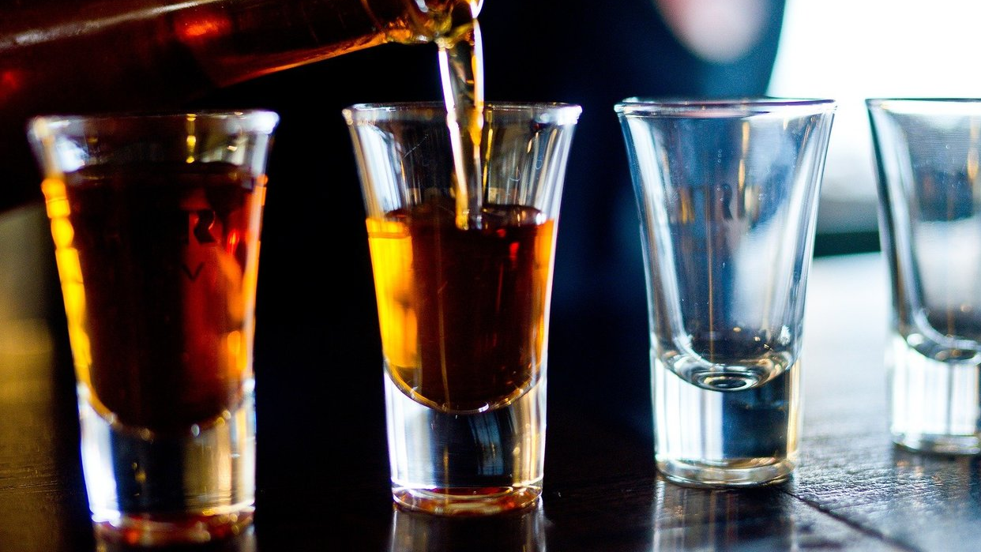
Student Alcohol consumption
Done by : Edwin Kutsushi , elsie felab , Claire Muthoni

Slide 2
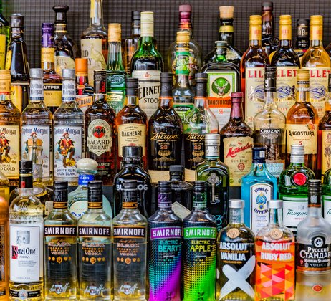
Background
…………………………………………

Slide 3

Analysis

Slide 4
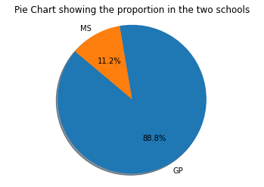
Which school had the most alcoholic students

Slide 5
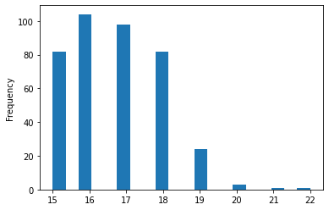
What age is most notorious for such behaviour

Slide 6
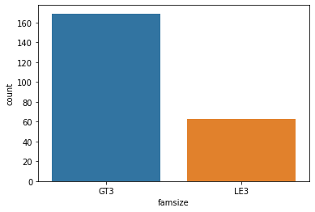
Which type of families have more alcoholic kids

Slide 7
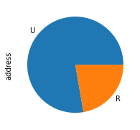
Are urban or rural kids more alcoholic

Slide 8


Slide 9
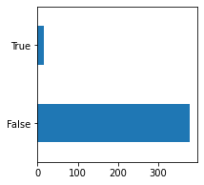
What proportion of the alcohol consuming students failed

Slide 10
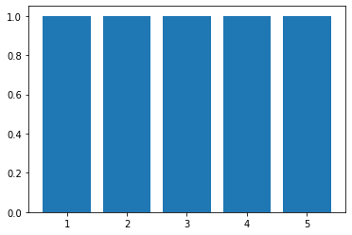
We would like to see if the students that go out a lot are likely to fail

Slide 11
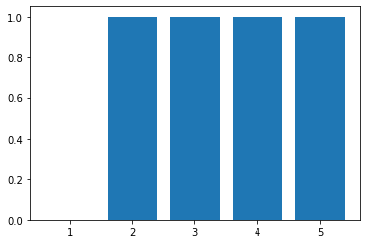
We would like to investigate if there is any chance that students with more free time fail the most

Slide 12
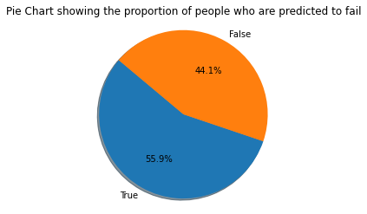
Our Findings

Slide 13


Slide 14


